Slide 1


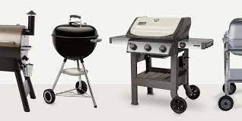
Charcoal or Propane? Presentation by: Mayank Thapliyal

Slide 2

Shall I go for a Charcoal Grill or a Propane grill? A question that has bugged humankind for half of the century.
Don’t worry. Yes, we have the answer.

Slide 3
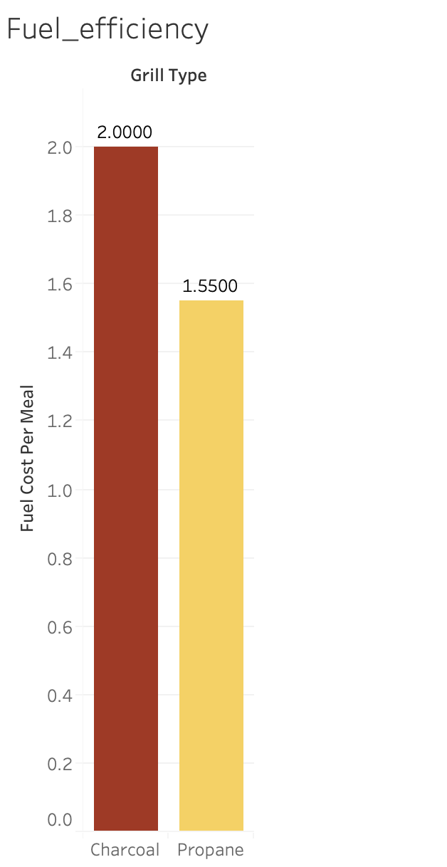
Charcoal grill requires fuel worth 2 $ for a single cookout while Propane grill does it for 1.55 $ So, is Propane grill better? Well, let’s not reach to conclusion so quick. Let’s analyze other factors too

Slide 4
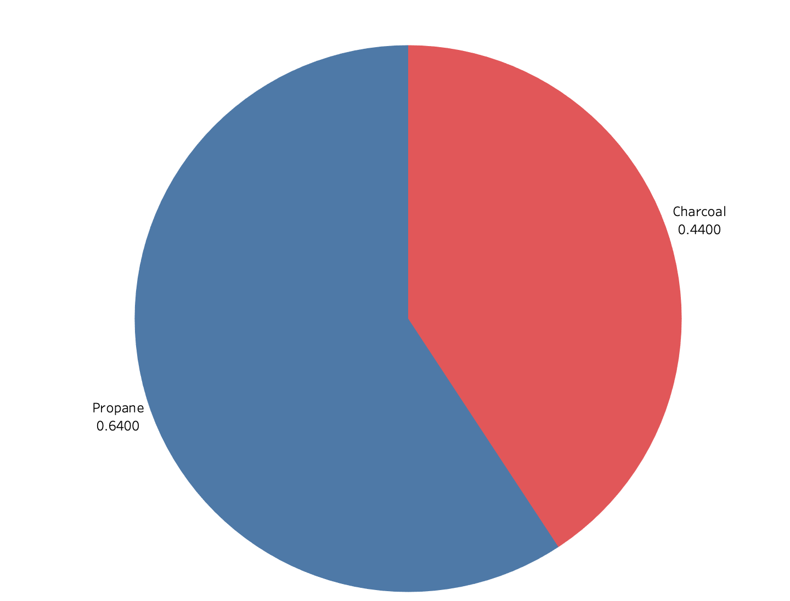
As for Market share it is Propane grill that dominates the customer choice with 64%

Slide 5
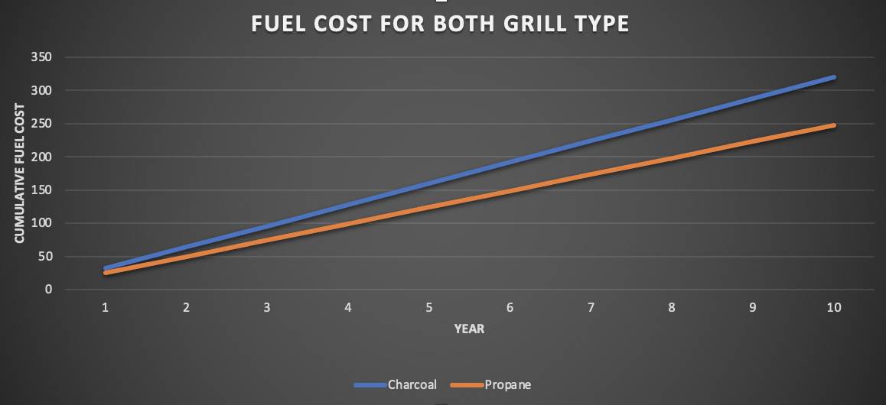
If checked for every year the difference between the Fuel cost keep increasing for both grill types

Slide 6
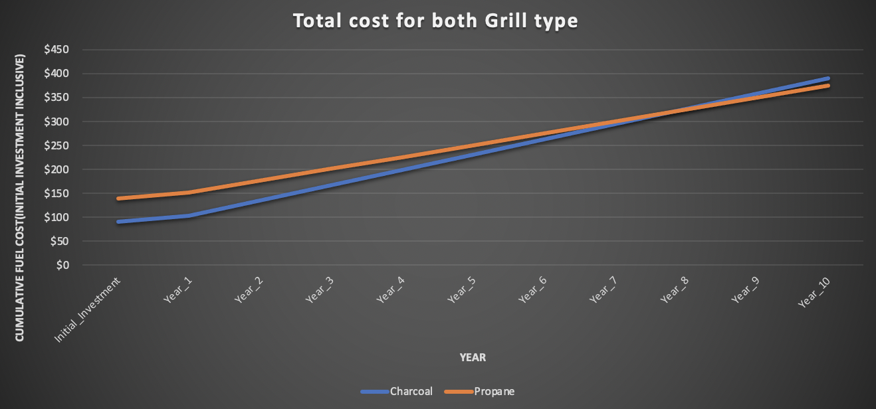
Bringing Initial investment as one of the factor in our analysis we see that charcoal grill cost less for 3 years and it takes 8 years for both grills to reach a break-even After 8 years Propane grill costs less. But does an average household use a grill for that long?

Slide 7
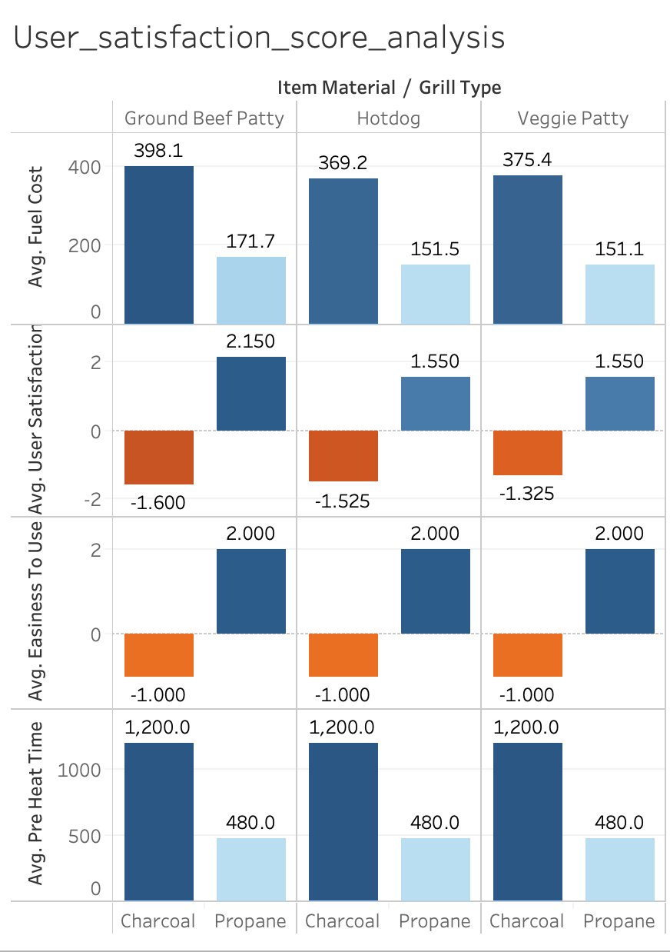
As per the survey, Average user experience for both grills across three food items : Ground Beef Patty, Hotdog and Veggie Patty, has stark difference. For Charcoal it is -1.5 and for Propane grill it is 1.75. The factors responsible for this difference could be: High average fuel cost for propane It is easier to clean Propane grill while Charcoal grill requires extra effort to clean ashes and extinguish flame with water Pre heat time for Charcoal is approximately 2.5 times that of Propane grill

Slide 8

Let’s talk about taste Food theory conducted an experiment where they served both fresh and reheated food items. Ground Beef Patty 40% people preferred patty grilled on Charcoal grill due to its smoky taste and same percentage of people preferred one grilled on Propane grill due to its traditional taste. 83 % people correctly identified the grill it was cooked on. Hot Dogs 40% people found hot dogs grilled on Propane grill tastier and 23 % preferred Charcoal grill. 93 % people correctly identified the grill. Veggie Patty 67% people found hot dogs grilled on Charcoal grill tastier and 23 % preferred Propane grill. 93 % people correctly identified the grill. Only 50 % correctly identified the grill.

Slide 9
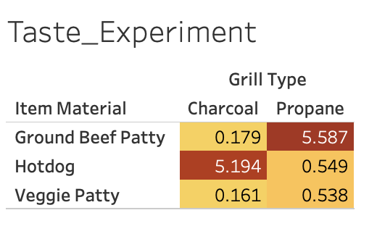
Recommendations to manufacturer: Customers prefer Propane grill when it comes to ease of use and pre-heat time. Charcoal grill is preferred when sole factor is Total cost. As Propane grill wins on two fronts. It is Propane grill that would be recommended to manufacturer. Taste is the factor that becomes imperative when households use grill only for grilling specific food items: Beef Patty - Propane recommended Hot Dogs - Charcoal recommended Veggie Patty - Propane recommended

